Slide 1
Running RMSD calculations (because we’re squares like that)
Kelly Brock
Takeda Group Meeting 3/1/2016

Slide 2
Reminder: Missense mutation project
Need calculations for destabilization
  Previously calculating ddG, too expensive
RMSD on minimization/equilibration
  Wildtype
  T 16 R (ddG = 0.5)
  L 14 A (ddG = -4.3)
Spoilers: more tractable, less physiological

Slide 3
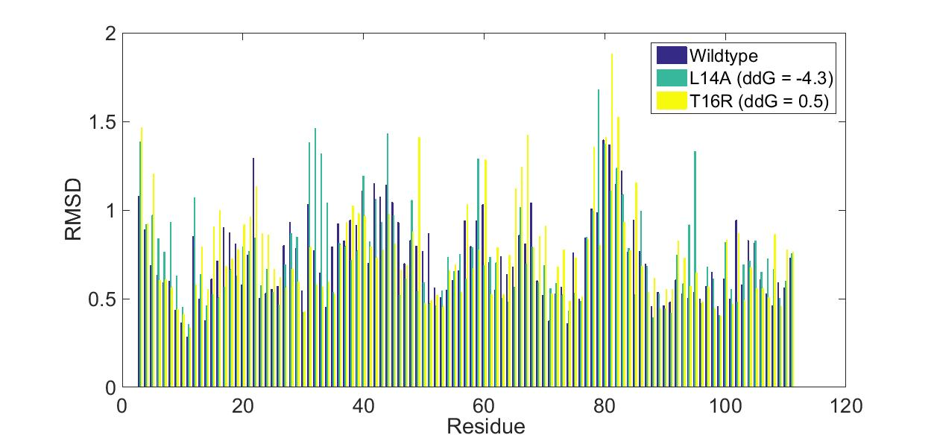
RMSD for two different mutations

Slide 4
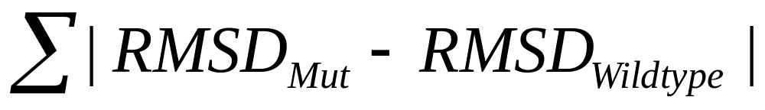
Not much difference in RMSD scores
L14A: 18.6652, <RMSD> = 0.7523
T16R: 19.4519, <RMSD> 0.7619
WT: <RMSD> 0.7280

Slide 5
Parameters of interest
Ran for 1 fs timestep, 100 min steps, runtime 5000
Increasing parameters and runtime
  20 frames -> 44 frames

Slide 6
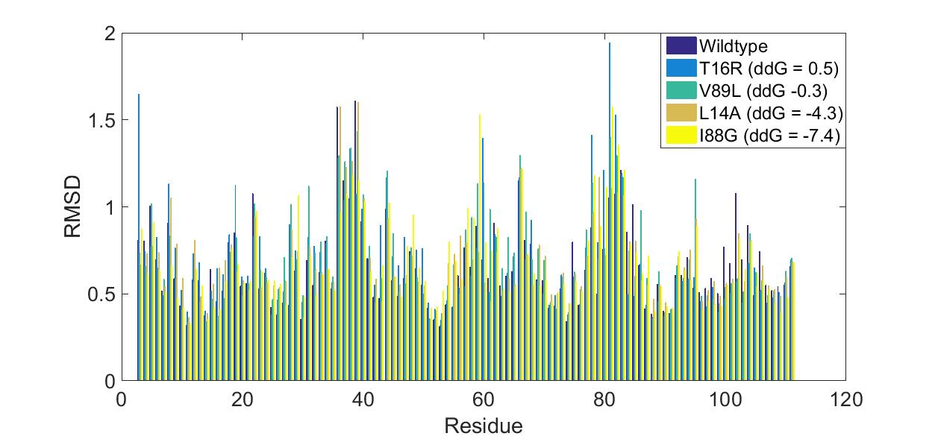
Longer timescale RMSD values

Slide 7
Values of distance from wildtype
L14A (ddG -4.3)
  11.0199
T16R (ddG 0.5)
  16.6230
I88G (ddG -7.4)
  13.9822
L89V (ddG -0.3)
  13.9970

Slide 8
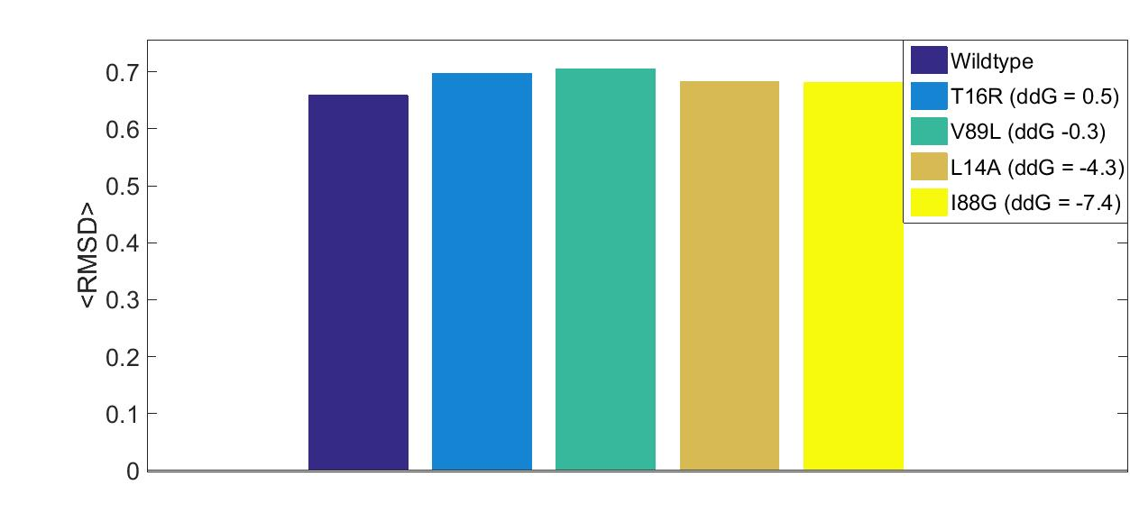
<RMSD> values for WT and mutants

Slide 9
Conclusions and next steps
Good at distinguishing wildtype from large scale destabilizations
Bad at distinguishing small versus large scale destabilizations (???)
Timesteps?

Slide 10
Update on CIN project
Last time: use binomial distribution to simulate ability to missegregate multiple chromosomes . . .

Slide 11
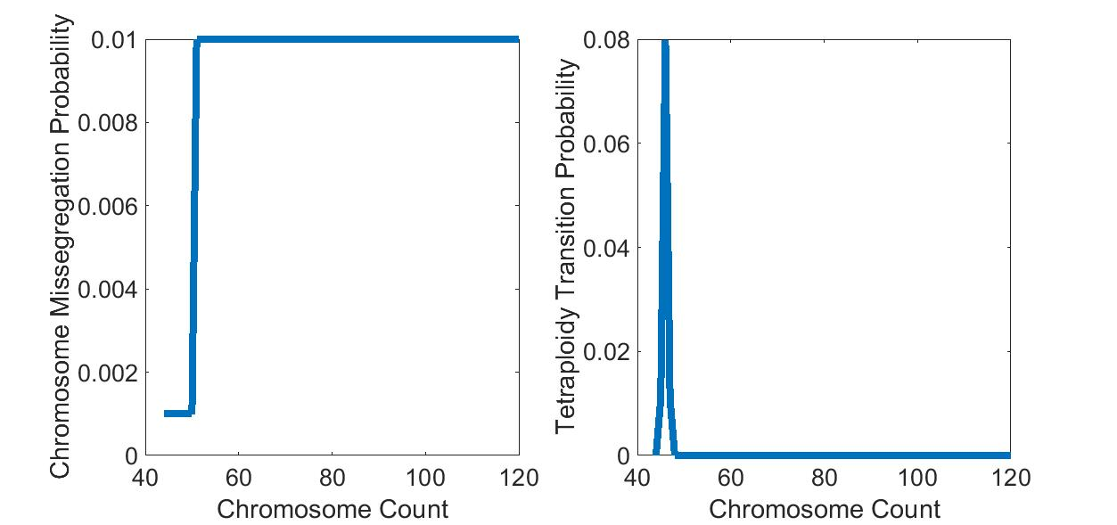
Parameters Used

Slide 12
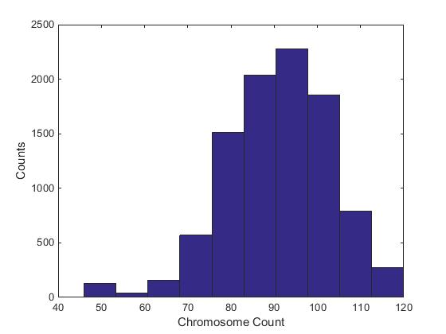
500 Generations

Slide 13
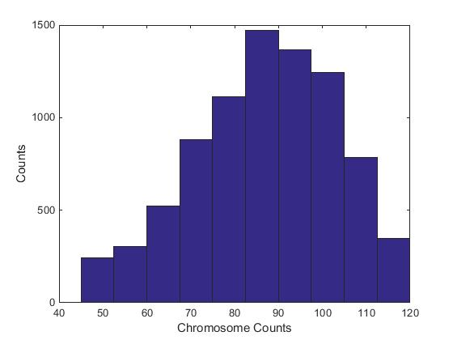
1500 Generations

Slide 14
Next steps
Parameters?
Incorporating fitness (die-off, relatively easy to implement if sample size large enough?)
Parameter sweep plausible

